Slide 1
Titleist Golf Project
Stat 795 Final Project
Aditya, Josh, Kelso

Slide 2
Outline
e Introduction/Methods
e Design of Experiment
e Model Selection/Diagnostics e Results
e Conclusion

Slide 3
Introduction
Problem
Titleist is suing a small business that is refurbishing used Titleist golf balls and selling them as new.
The company claims that since the balls are practically new that there is no difference in performance between new Titleist balls and the refurbished ones.

Slide 4
Introduction
Goal
We want to show that that there is a measurable difference in the performance of the different golf ball types
Showing a difference in a single metric constitutes a difference among ball types

Slide 5
Design of Experiment
Randomization is key to any Experimental Design
Power of .95 used to determine optimal sample size
Primary golf ball characteristics of note:
Distance
Accuracy
Control

Slide 6
Design of Experiment
We will first check distance, and then go from there if there is no measurable difference among ball types.

Slide 7
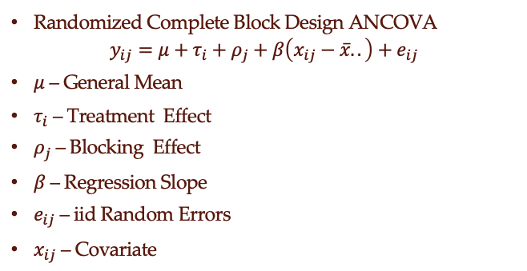
Design of Experiment
Randomized Complete Block Design ANCOVA
$$y_{ij}=μ+τ_{i}+ρ_{j}+β\left(x_{ij}−\overline{x}..\right)+e_{ij}$$
$μ$ – General Mean
$τ_{i}$ – Treatment Effect
$ρ_{j}$ – Blocking Effect
$β$ – Regression Slope
$e_{ij}$ – iid Random Errors
$x_{ij}$ – Covariate

Slide 8
Design of Experiment
N
W
N
R
R
W
Block 1
W
N
W
R
N
R
Block 2
N
R
N
W
R
W
Block 42

Slide 9
Data Set
Multiple measurements taken for each shot
Total Distance
Total Dispersion
Carry Dispersion
Carry Distance

Slide 10
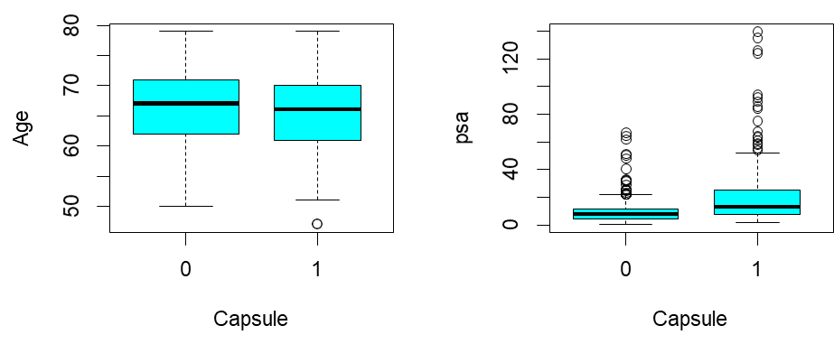
Exploratory Data Analysis
Continuous Predictors
2-sample T-test for difference between means of two groups
Positive relationship between PSA value and tumor penetration
Cohen’s D used to corroborate data
Age was of negligible effect
PSA was of moderate effect

Slide 11
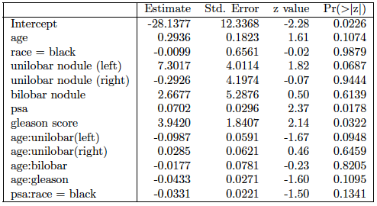
Model Selection
Reduced Model after Backward Selection

Slide 12
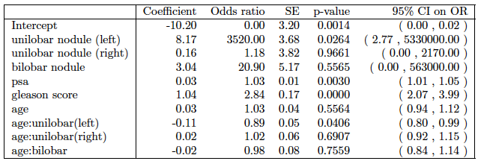
Model Selection
Interaction Model (Candidate 1)

Slide 13
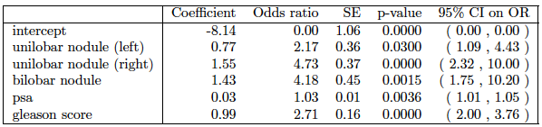
Model Selection
Reduced Model (Candidate 2)

Slide 14
Model Selection
Reduced Model
Two candidate reduced models done by stepwise model selection with AIC and p-value analysis, respectively
ANOVA shows that both models are significantly different from full model, but not significantly different from each other
Final reduced model without interaction terms

Slide 15
Model Diagnostics
For the model diagnostic analysis, PSA was converted to a categorical variable by binning the values into 8 categories.
Graphs of measures of influence depicted potential outliers.
None of these outliers displayed multiple measures of influence outside of their respectable cutoffs. Therefore, no data were removed.
Interpretation of the final model requires consideration of the odds ratios for each predictor in relation to detection of capsular penetration.

Slide 16
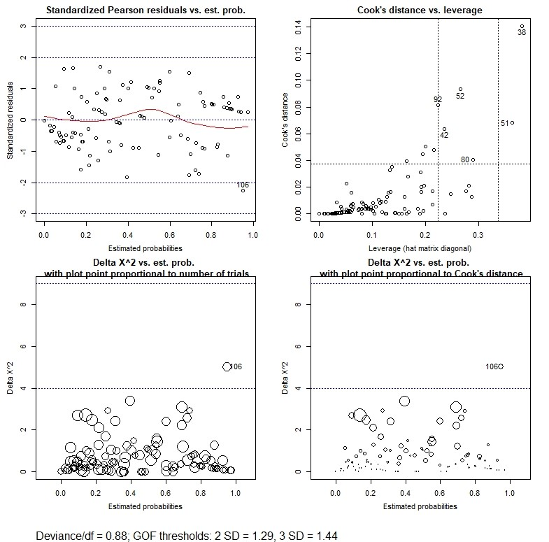
Model Diagnostics

Slide 17
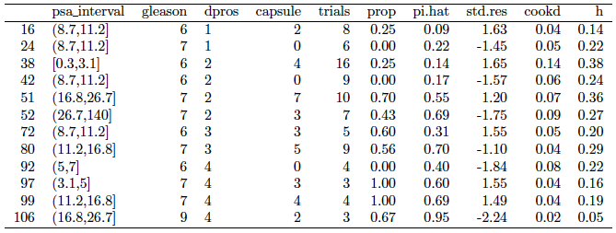
Model Diagnostics

Slide 18
Inferences
Odds ratio for each predictor is calculated by transforming the respective coefficient estimates by e^{β}

Slide 19
Conclusion
Analysis of the final reduced model shows a sensitivity of 0.77 and specificity 0.78.
Higher sensitivity is preferred over specificity, in this case.
Verifies that model has highest chance of properly predicting capsular penetration based on baseline diagnostic measurements.
Limitations:
Sample size limits ability to improve variability of model
Other important variables (i.e. diet, exercise, smoking, etc.) would help improve the model

Slide 20
References
e “SEER Cancer Fact Sheet: Prostate Cancer”. NIH. https://seer.cancer.gov/statfacts/html/prost.html. Retrieved 13
November 2018.
e “Prostate Cancer Treatment”. National Cancer Institute. https://www.cancer.gov/types/
prostate/patient/prostate-treatment. Retrieved 13 November
2018.
e Ruddon, Raymond W. (2007). Cancer biology (4th ed.). Oxford: Oxford University Press. p. 223. ISBN 9780195175431.
e Clinical and pathological significance of the level and extent of
capsular invasion in clinical stage T1–2 prostate cancer. TM Wheeler, O Dillioglugil, MW Kattan, A Arakawa. - Human pathology, 1998.
e “Interpreting Diagnostic Tests”.
http://gim.unmc.edu/dxtests/roc3.htm. Tape, Thomas G. MD. University of Nebraska Medical Center. Retrieved 13 November 2018.

